Slide 1
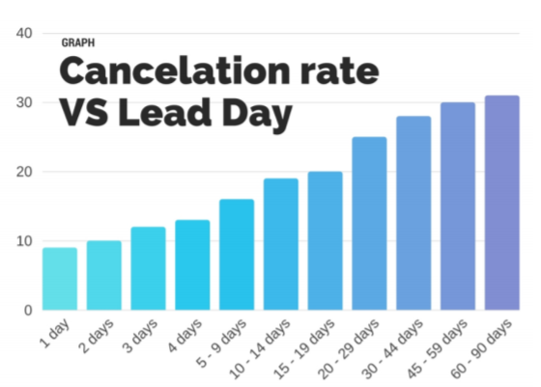
Business Problem Understanding
The problem statement provides us with insights regarding the increasing number of cancellation on hotel bookings by customers.
Cancellation on hotel bookings have become a major issue which has impacted the hospitality sector financially leading to huge losses and not able to retain their customers in the long run.
The same can be explained from the graph which depicts the number of days after the booking is done and the cancellation which takes place in the upcoming days.

Slide 2
Business Problem Understanding(Contd.)
Now the question which arises is that why we should we study the cancellation trend?
The answer for this is that if with the help of the data we can predict which customer will cancel their bookings before they even cancel it we can save lot of resources.
These same resources can be utilized for the customers which are genuine or loyal to us and can provide them with good facilities which in return can help us build a strong customer base and allow us to expand ever further than we expect.

Slide 3
Modelling Approach Used and Why?
The problem statement which we are observing here is more inclined towards the classification problem which means that we are classifying that if a customer will cancel the reservation or not.
The modelling approach which can be used in these types of problem statements are:
Logistics Regression Model
Linear Discriminant Analysis Model
Random Forest Classifier Model
Decision Tree Classifier Model
Ada Boost Classifier Model
MLP Classifier Model

Slide 4
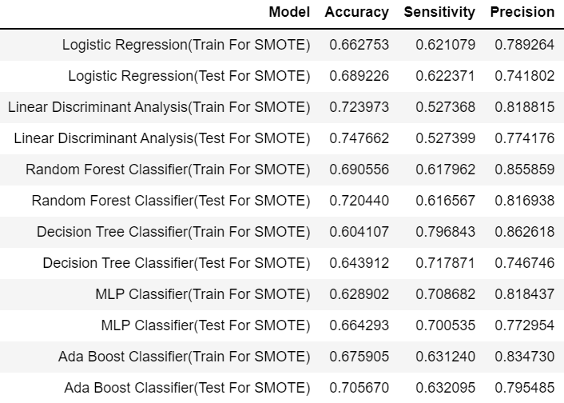
Modelling Approach Used and Why(Contd.) ?
The model outputs for train and test are collated in tabular format which will give us a better picture of how our models are performing:
In our scenario we are looking for the best model which meets our all three performance metric requirements.
As we can observe the model which is giving us a higher accuracy for both train and test data is Linear Discriminant Model but its Sensitivity is quite low so we can cannot select this model.

Slide 5
Modelling Approach Used and Why(Contd.) ?
If we compare all the models we come to a conclusion that the best model which has all performance metrics consistent is the Random Forest Classifier.
Now as discussed in the previous slide we are dealing with a classification problem in which we have to predict which customer will cancel their reservation and which customer will not.
For this we have to understand how does Random Forest Classifier works when the data set is fed into the model.
Random forest is a supervised learning algorithm. The "forest" it builds, is group of decision trees. Each decision tree is fed with different combinations of variables and row samples and then the outputs generated according to our problem statements are in the form of 0’s and 1’s

Slide 6
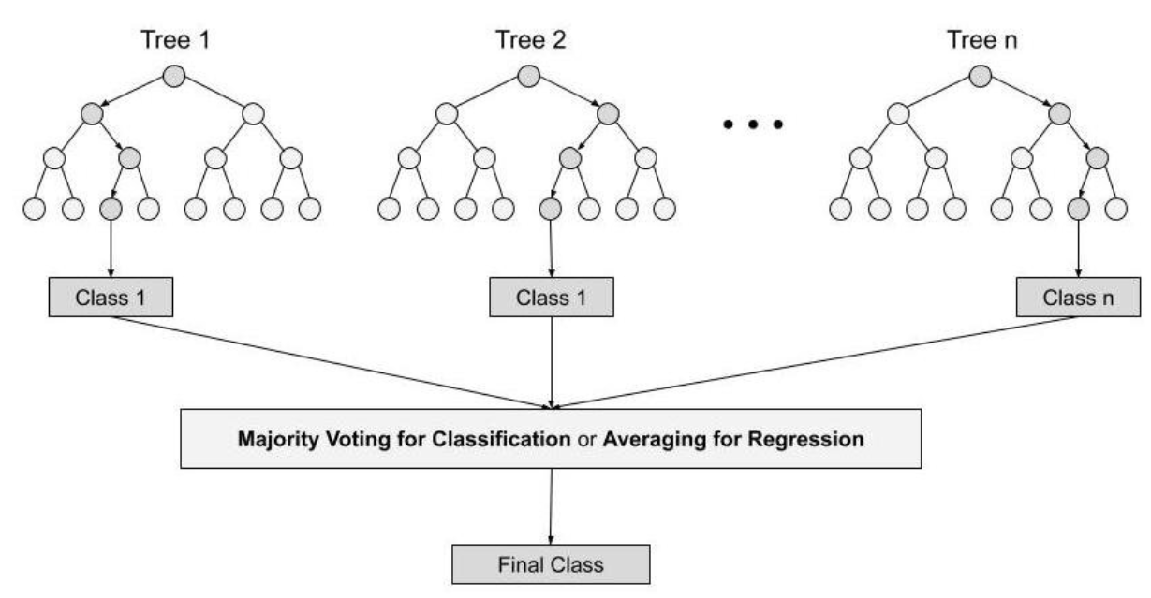
Modelling Approach Used and Why(Contd.) ?
Then with the help of voting we check for the most number of occurrences which has taken place.
If the number of 0’s are more we can conclude that the customer will not cancel the reservation and if number of 1’s are more then it indicates that there are high chances that the customer might cancel their reservations.
The decision trees inside the Random Forest Classifier looks like this:

Slide 7
Insights
After analysing the data their were few variables which did not have good amount of impact on the dependent variable and also these variables were having a lot of missing or NA values.
The variable is dropped from the data set when it does not meet our criteria which are:
When we are not able to identify the relationship between the dependent and independent variables and any changes in independent variables does not impact the dependent variable the that variable is to be dropped.
If the variable has more than 20% missing values then it has to be dropped as it might give us biased or no proper outcomes.
The variables according to our analysis which has some impact on our cancellations are:

Slide 8
Insights (Contd.)
Market_Segment: The platform through which customers have booked their bookings. There are some observations to be taken out from this variable which are:
Most of the customers prefer online platforms for booking their reservations with around 56,477 customers booking online.
But, from that 20,739 customers cancel their reservations which is quite a lot as compared to those customers who have booked directly from the hotel website.
Deposit_Type: Deposit type means that weather a customer has to pay some token amount for the reservation of room the observations made here are:
Around 14,587 customers have gone with Non- Refundable policy which means that in case they cancel their booking they will not be receiving their token money back.
But, in this scenario as well there are around 14,494 customers who have cancelled their bookings which raises a concern in the Non – Refundable policies of the hotel
Customer_Type: The customer type for which the cancellations are high are for customers who do their bookings at the very last moment. From 84,613 bookings at the last moment their was a cancellation of around 36,514 which is quite high.

Slide 9
Recommendations
Recommendations are some measures which can be taken by the hotel owners and staff to reduce their cancellation rate. Some of these include
Non Refundable policies should be made strict which means that if a customer has made a reservation a token amount should be taken as a confirmation that the customer will not cancel their reservations and if they do so the money they have deposited should not be refunded to them.
Secondly, the cancellation rate while booking through online platforms is quite high as there can be some leniency which these online portals provide which makes it easy for the customer to cancel their bookings anytime.
To deal with this hotel should promote their website more and provide better deals as compared to other online portals so that the cancellation rate can be reduced.
Some hotels only provide Breakfast which can be a turn off for a customer and this needs to changed according to customers preference. Which means that customer should decide which meals they should opt for and hotel can discuss on what extra charges they will be paying for it.
Try to be connected with the customers through phone, mail etc. to get the idea that how the customer will be travelling and reaching to the hotel or any service which can be provided from our side to make their experience more better.

